Slide 1
2019 Q1 VHV support
TINR

Slide 2
LPPS MK4 introduction support – System Hardware Setup Tool
CLM ACPD issues – Task 630

Slide 3
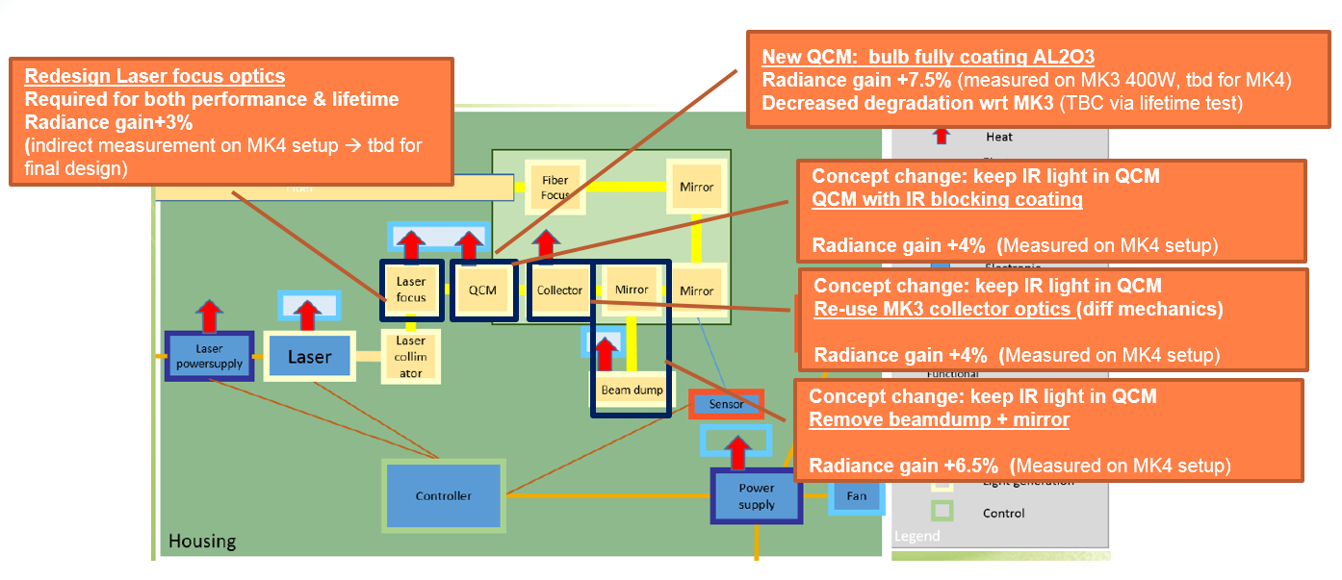
Improvement from LPPS MK3 to MK4
The main performance driver for LPPS MK4 is the increase in Spectral Radiance with a factor 1.7x (weighted average) when compared to the LPPS MK2/3.
LPPS MK4: 1.6x
Coating CL2Shutter fiber: 1.06x
--------------------------------------
Total radiance increase 1375: 1.7x
Improved diagnostics and communication to the laser.
Minimize Cost of Goods and make volume available
→ Removal of Color filtering functionality/ shutterbox w/o attenuator
Radiance improvement in LPPS 1.27x → 1.6x:
Redesign laser focus optics
New QCM coating → Al2O3
Reuse IR light

Slide 4
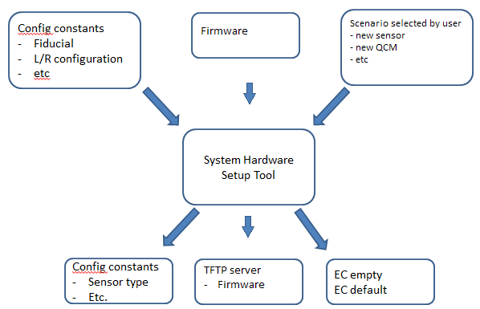
Support LPPS MK4 introduction - System Hardware Setup Tool
The hardware setup tool prepares the system for recovery after a spare part swap or hardware upgrade.
It achieves this by setting the correct configuration and equipment constants

Slide 5
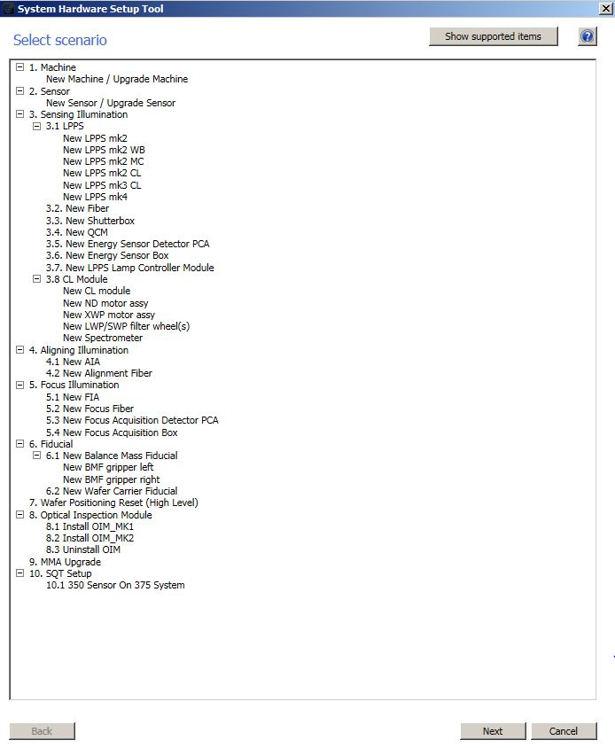
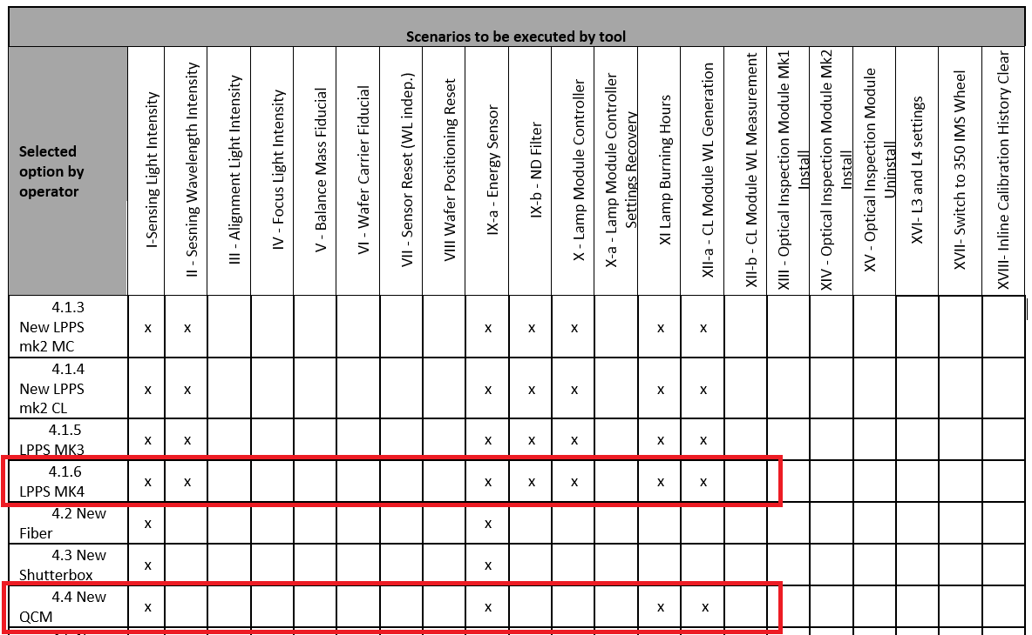
SHST support
Reset configuration constants and ECs depending on the selected scenarios.
5 newly introduced error/warning codes for SHST to support LPPS MK4 introduction.

Slide 6
Performance task 630 – CLM Spectral performance
Calibration tasks
602
Create spectra to encoder position table
Time required: 44 min
603
Correct offset of spectra to encoder position for selected wavelengths
Time required: 5 min
Performance tasks
630
602
603
Drift
Measured spectra
Report

Slide 7
Performance task 630 - Issues
Issue 1- Task #630 wants to apply the #603 correction without running it
Fix 1 - Input setting “Execute corrected step” to False only for YS375 machines. The other machines should have the same old default values for this input setting
Issue 2 - 1375 CL module task #630 fails when running it a second time with different input settings, only way to run is to add drift measurement
Fix 2 - Always removing duplicates from the WL-BW combinations lists before running the task.
Issue 3 - CLM task #630 reporting fails when only one bandwidth is selected - figure building requests at least 2 bandwidths
Fix 3 –
Code is handling the number of unique BWs in a generic way (1 -> ∞)
In case of 2WL-1BW combinations, the dimensions for the X-axis and Y-axis are calculated in a better way

Slide 8
Lesson learned
Participate in LPPS MK4 introduction
Understand SHST operation mechanism -> useful for swapping of other components or upgrading.
Calibration task 603 is not supported for YS 375 and is only supported for YS 1375.

Slide 10
SHST – newly introduced error/warning codes
Error - The missing of copyLPPSfirmware.bat
Error – Hardware and Firmware not match
Error – Firmware upgrading while lamp is on
Error – Firmware upgrade failure due to network not working
Warning - Firmware update skipped because latest version already available.

Slide 11
Introduce QCM with more robust coating material (Al2O3):
Higher melting temperature (340dC higher)
Higher chemical stability
no chemical reaction w. contaminants

